Slide 1
Circuit Lower Bound

Slide 2
Small Circuit for Parity
Def:
Fact: Depth 2 circuits computing parity are of size 2^{n-1}. The circuit can be written either as an AND of ORs or an OR of ANDs.

Slide 3
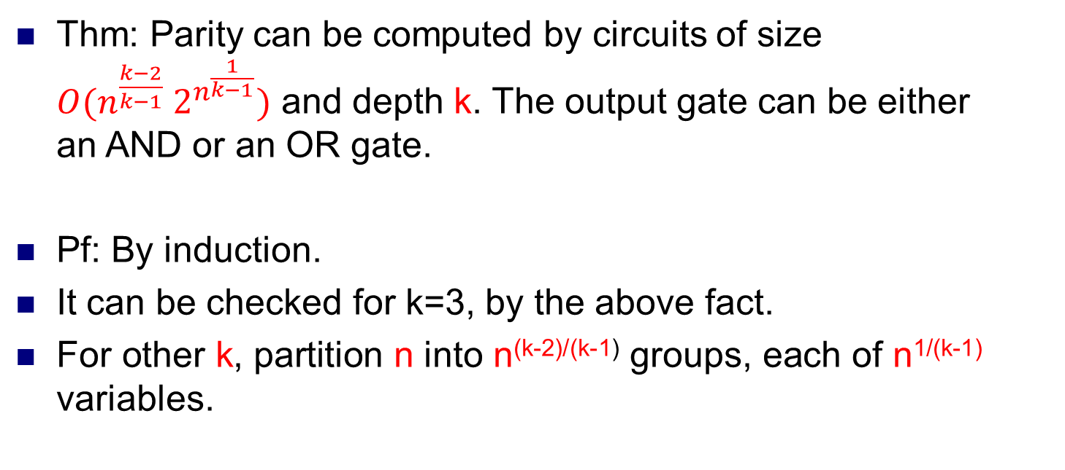
Thm: Parity can be computed by circuits of size $O(n^{\frac{k−2}{k−1}} 2^{n^{\frac{1}{k−1}}})$ and depth k. The output gate can be either an AND or an OR gate.
Pf: By induction.
It can be checked for k=3, by the above fact.
For other k, partition n into n^{(k-2)/(k-1)} groups, each of n^{1/(k-1)} variables.

Slide 4
n^{(k-2)/(k-3)}
K-1
……
2
n^{1/(k-1)}
n^{1/(k-1)}

Slide 5
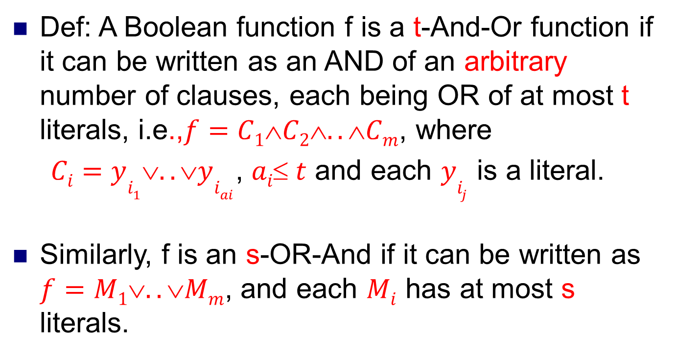
Def: A Boolean function f is a t-And-Or function if it can be written as an AND of an arbitrary number of clauses, each being OR of at most t literals, i.e.,$f=C1C2..Cm$, where
$Ci=yi_{1}..yi_{ai}$, $ai t$ and each $yi_{j}$ is a literal.
Similarly, f is an s-OR-And if it can be written as $f=M1..Mm$, and each $Mi$ has at most s literals.

Slide 6
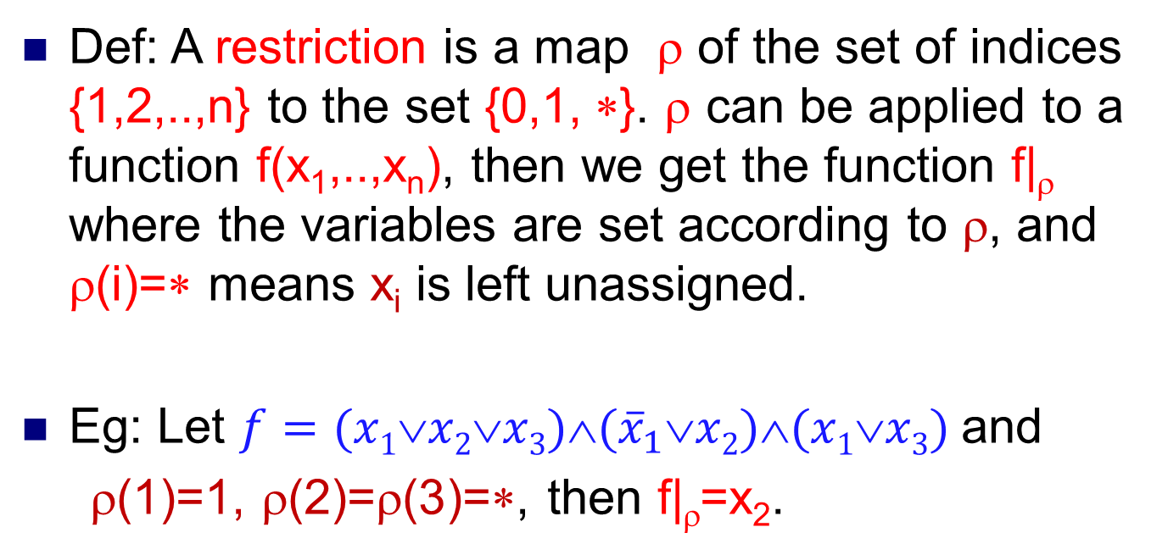
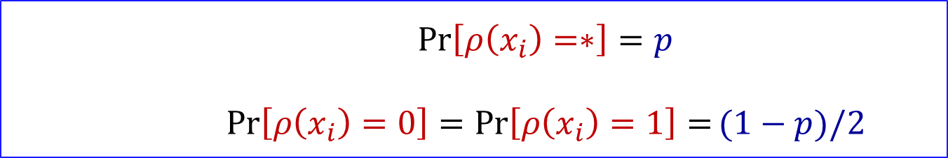
$$\operatorname{Pr}\left[ρ\left(x_{i}\right)=∗\right]=p$$
$\operatorname{Pr}\left[ρ\left(x_{i}\right)=0\right]=$ $\operatorname{Pr}\left[ρ\left(x_{i}\right)=1\right]=(1−p)/2$
Def: A restriction is a map ρ of the set of indices {1,2,..,n} to the set {0,1, ∗}. ρ can be applied to a function f(x₁,..,x_{n}), then we get the function f|_{ρ} where the variables are set according to ρ, and ρ(i)=∗ means x_{i} is left unassigned.
Eg: Let $f=(x1∨x2∨x3)∧({\overline{x}}_{1}∨x2)∧(x1∨x3)$and
ρ(1)=1, ρ(2)=ρ(3)=∗, then f|_{ρ}=x₂.

Slide 7
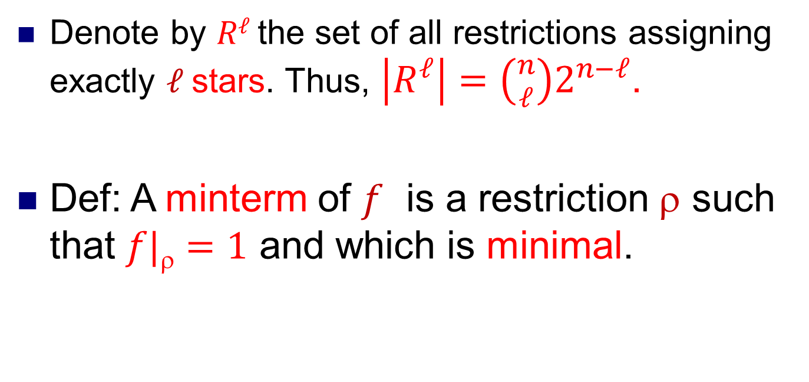
Denote by $Rℓ$the set of all restrictions assigning exactly $ℓ$stars. Thus, $\left|R^{ℓ}\right|=\left({n \atop ℓ}\right)2^{n−ℓ}$.
Def: A minterm of $f$ is a restriction $$ such that $f|=1$ and which is minimal.

Slide 8
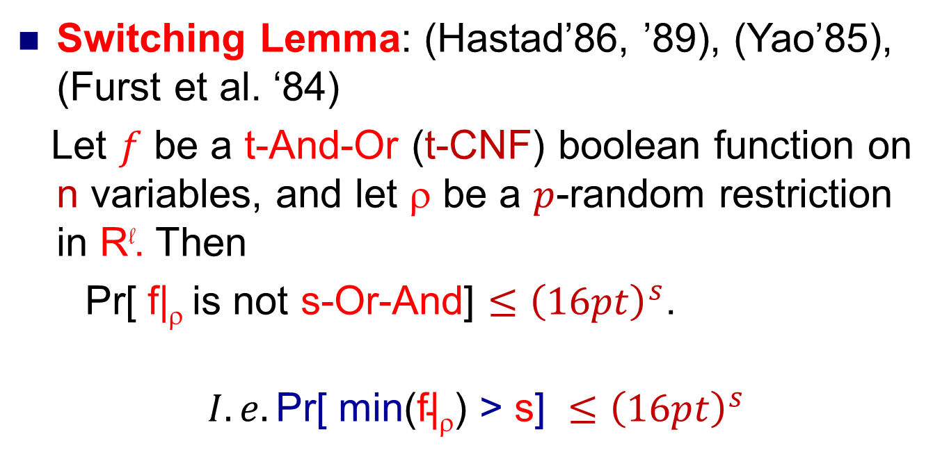
Switching Lemma: (Hastad’86, ’89), (Yao’85), (Furst et al. ‘84)
Let $f$ be a t-And-Or (t-CNF) boolean function on n variables, and let ρ be a $p$-random restriction in R^{l}. Then
Pr[ f|_{ρ} is not s-Or-And] $≤{\left(16pt\right)}^{s}$.
$$I.e.\text{Pr}\text{[ }\text{min}\text{(}\text{f}\text{|ρ) >} \text{s}\text{]} ≤{\left(16pt\right)}^{s}$$

Slide 9
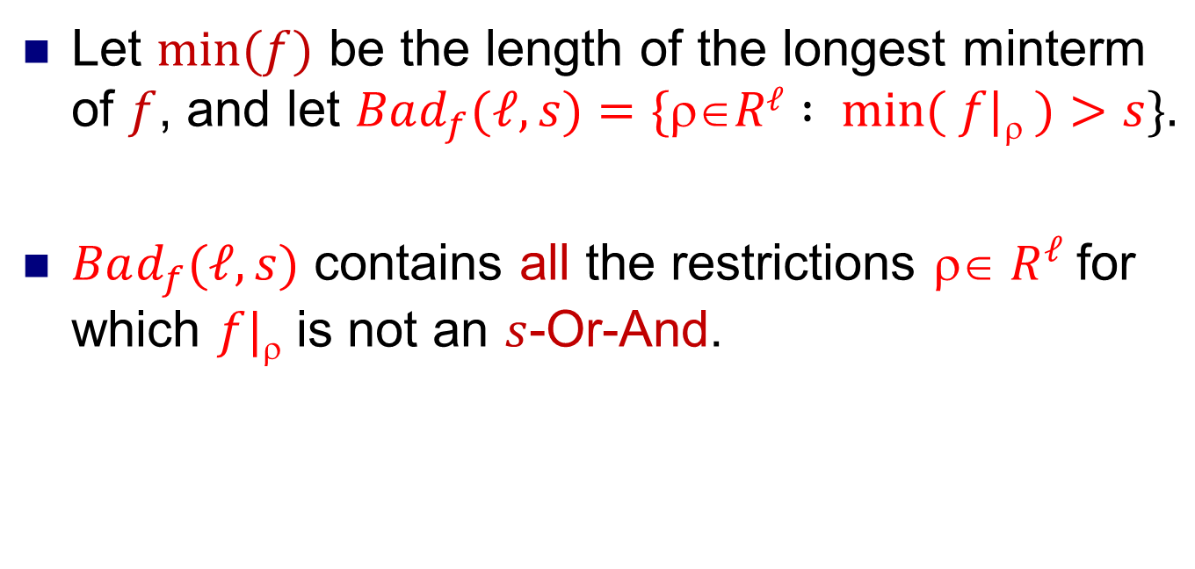
Let $min⁡(f)$ be the length of the longest minterm of $f$, and let $Bad_{f}(ℓ,s)=\{Rℓ : min⁡( f|❒ )>s\}.$
$Bad_{f}(ℓ,s)$ contains all the restrictions $ R^{ℓ}$for which $f|$ is not an $s$-Or-And.

Slide 10
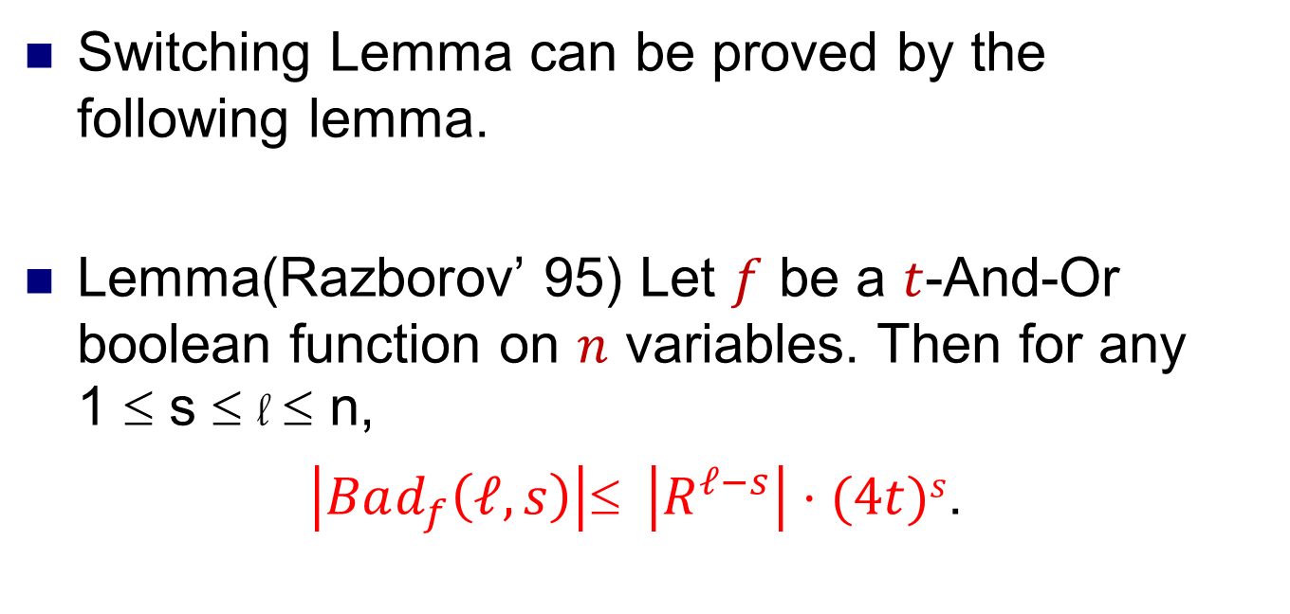
Switching Lemma can be proved by the following lemma.
Lemma(Razborov’ 95) Let $f$ be a $t$-And-Or boolean function on $n$ variables. Then for any 1 ≤ s ≤ l ≤ n,
$\left|Bad_{f}\left(ℓ, s\right)\right|≤ \left|R^{ℓ−s}\right|⋅(4t)s$.

Slide 11
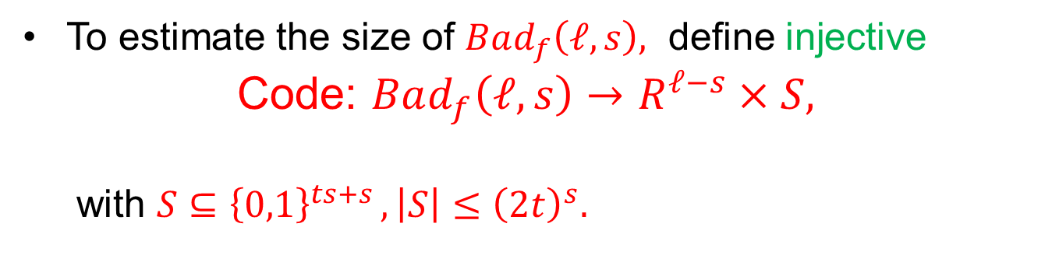
To estimate the size of $Bad_{f}\left(ℓ, s\right),$ define injective
Code: $Bad_{f}\left(ℓ, s\right)→R^{ℓ−s}×S,$
with $S⊆$ ${\left\{0,1\right\}}^{ts+s },\left|S\right|≤{\left(2t\right)}^{s}.$
A
B
Code

Slide 12

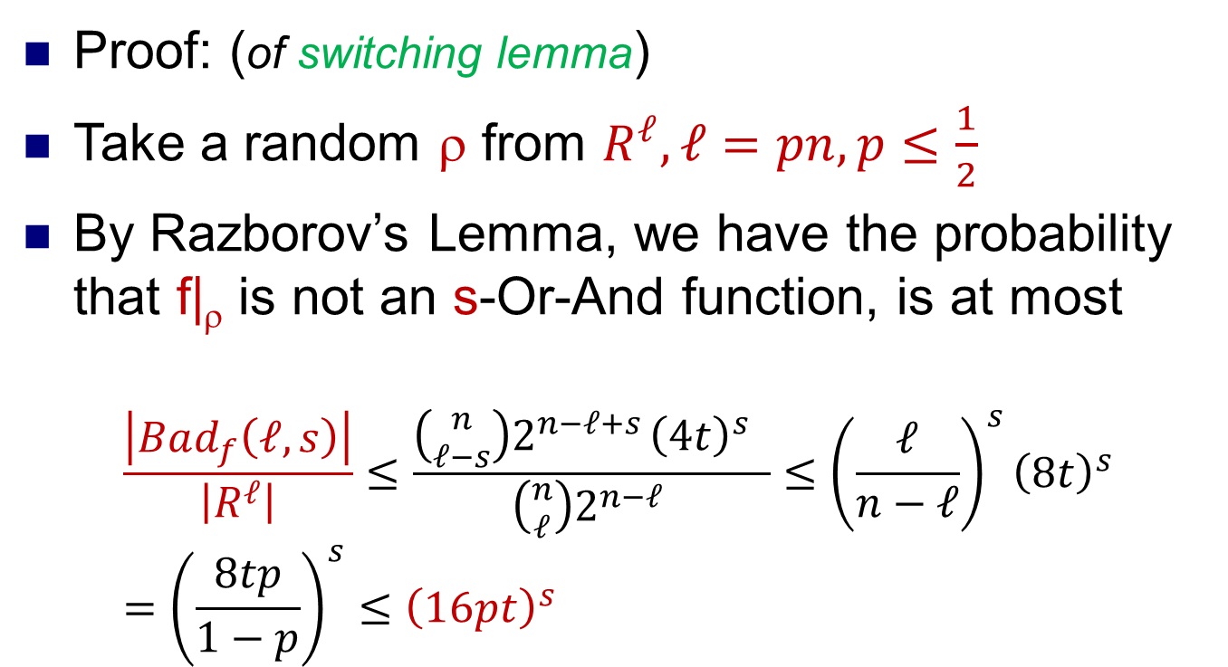
$$\left|Bad_{f}\left(ℓ, s\right)\right|≤ \left|R^{ℓ−s}\right|⋅(2t)s$$
Proof: (of switching lemma)
Take a random ρ from $R^{ℓ}, ℓ=pn, p≤\frac{1}{2}$
By Razborov’s Lemma, we have the probability that f|_{ρ} is not an s-Or-And function, is at most
$$\frac{\left|Bad_{f}\left(ℓ, s\right)\right|}{\left|R^{ℓ}\right|}≤\frac{\left({n \atop ℓ−s}\right)2^{n−ℓ+s }{\left(4t\right)}^{s} }{\left({n \atop ℓ}\right)2^{n−ℓ }}≤{\left(\frac{ℓ}{n−ℓ}\right)}^{s}{\left(8t\right)}^{s}={\left(\frac{8tp}{1−p}\right)}^{s}≤{\left(16pt\right)}^{s}$$

Slide 13
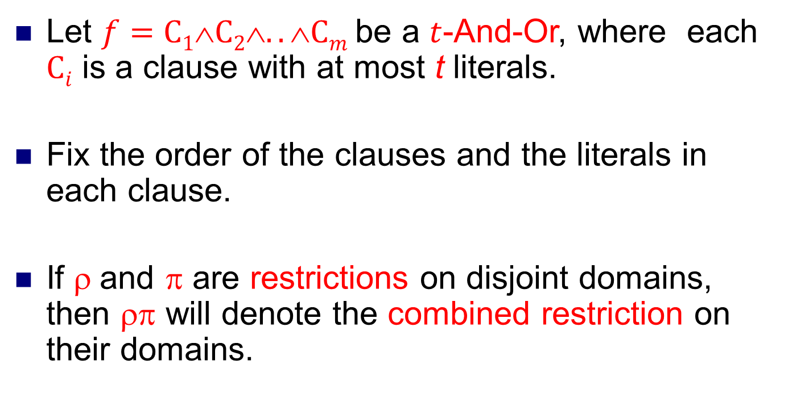
Proof:(of Razborov’s Lemma)
Let $f=C1C2..Cm$be a $t$-And-Or, where each $Ci$ is a clause with at most t literals.
Fix the order of the clauses and the literals in each clause.
If ρ and π are restrictions on disjoint domains, then ρπ will denote the combined restriction on their domains.

Slide 14
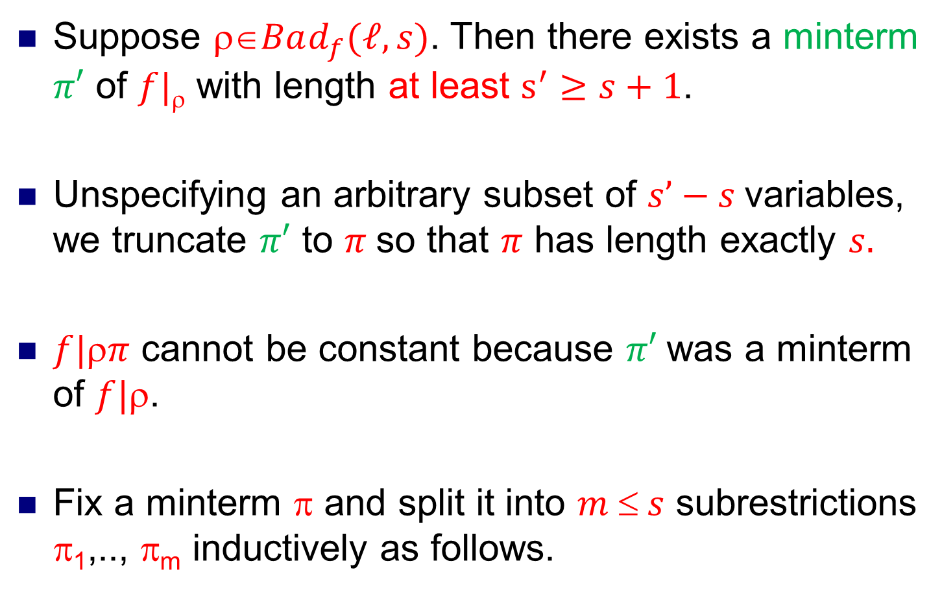
Suppose $Bad_{f}(ℓ,s)$. Then there exists a minterm $π′$ of $f|$ with length at least $s^{′}≥s+1$.
Unspecifying an arbitrary subset of $s’−s$variables, we truncate $π′$ to $π$so that $π$ has length exactly $s.$
$f|π$ cannot be constant because $π′$was a minterm of $f|$.
Fix a minterm π and split it into $m  s$ subrestrictions π₁,.., π_{m} inductively as follows.

Slide 15
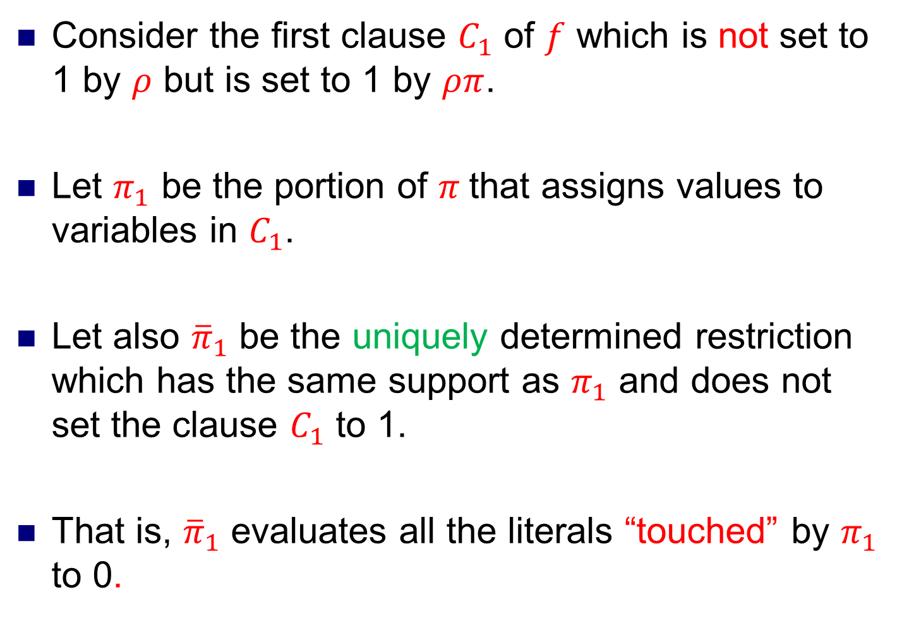
Consider the first clause $C_{1}$ of $f$ which is not set to 1 by $ρ$ but is set to 1 by $ρπ$.
Let $π_{1}$ be the portion of $π$that assigns values to variables in $C_{1}$.
Let also ${\overline{π}}_{1}$ be the uniquely determined restriction which has the same support as $π_{1}$ and does not set the clause $C_{1}$ to 1.
That is, ${\overline{π}}_{1}$ evaluates all the literals “touched” by $π_{1}$ to 0.

Slide 16
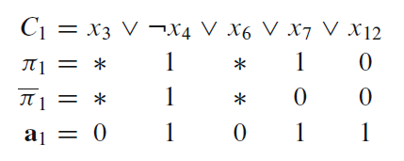
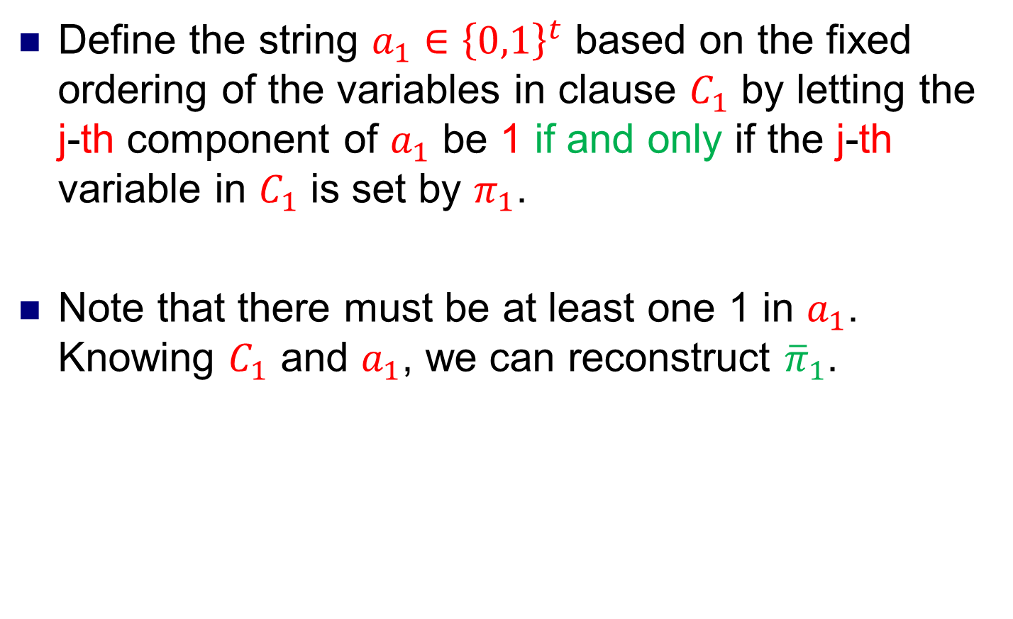
Define the string $a_{1}∈{\left\{0,1\right\}}^{t}$ based on the fixed ordering of the variables in clause $C_{1}$ by letting the j-th component of $a_{1}$ be 1 if and only if the j-th variable in $C_{1}$ is set by $π_{1}$.
Note that there must be at least one 1 in $a_{1}$. Knowing $C_{1}$ and $a_{1}$, we can reconstruct ${\overline{π}}_{1}$.

Slide 17
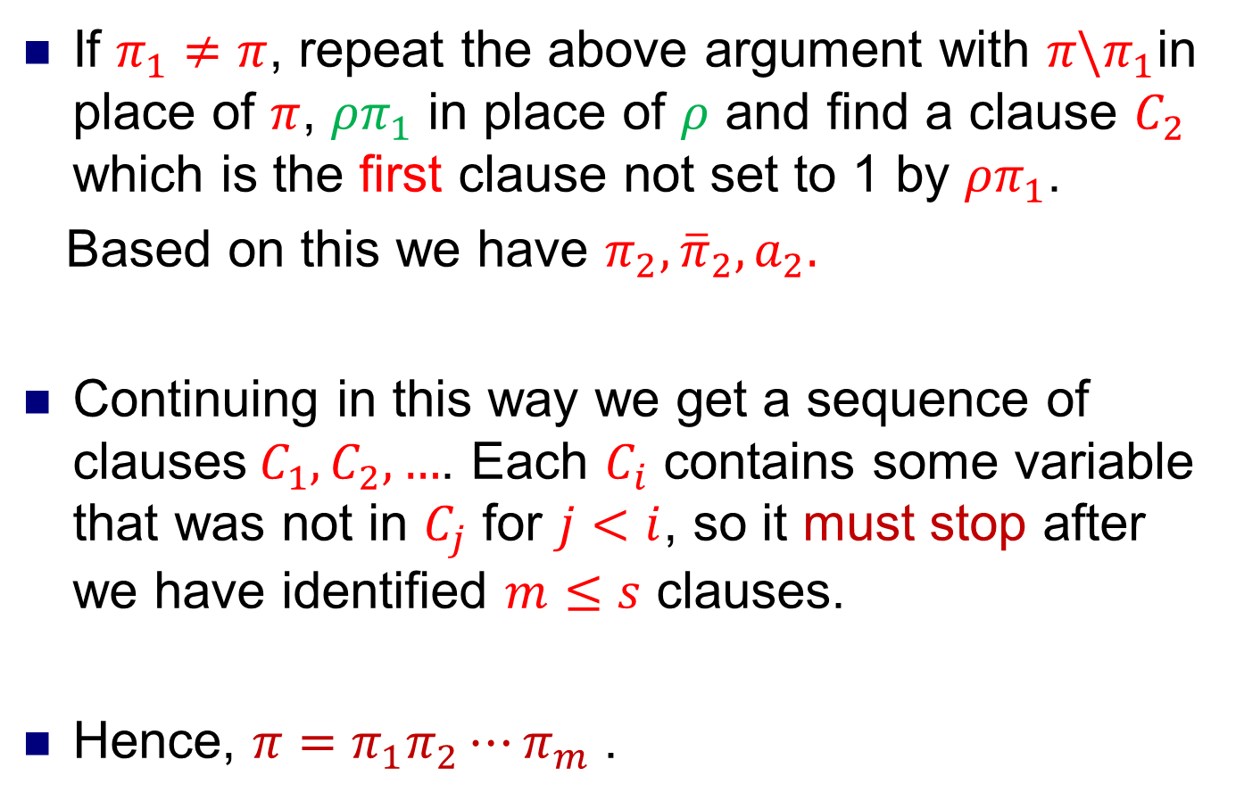
If $π_{1}≠π$, repeat the above argument with $π\backslash π_{1}$in place of $π$, ${ρπ}_{1}$ in place of $ρ$ and find a clause $C_{2}$ which is the first clause not set to 1 by ${ρπ}_{1}$.
Based on this we have ${π_{2},\overline{π}}_{2}, a_{2}.$
Continuing in this way we get a sequence of clauses${ C}_{1},C_{2},…$. Each $C_{i}$ contains some variable that was not in $C_{j}$ for $j<i$, so it must stop after we have identified $m≤s$ clauses.
Hence, $π=π_{1}π_{2}⋯π_{m}$.

Slide 18
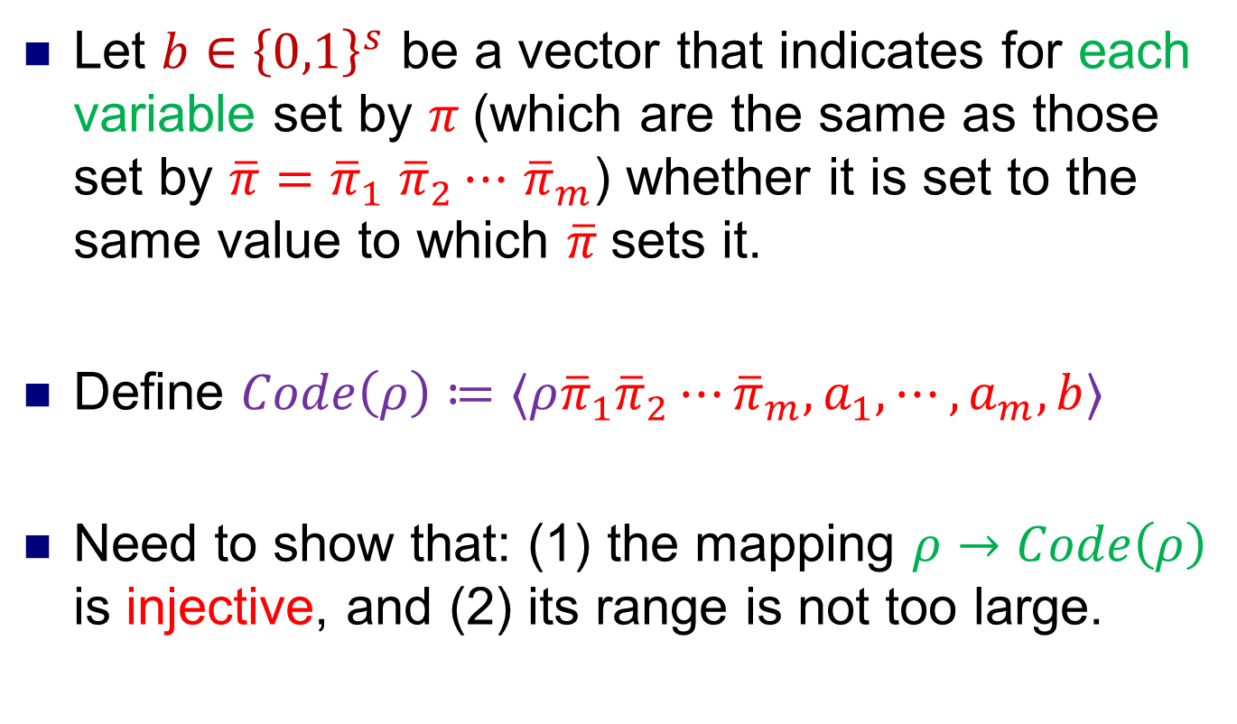
Let $b∈{\left\{0,1\right\}}^{s}$ be a vector that indicates for each variable set by $π$(which are the same as those set by $\overline{π}=$ ${\overline{π}}_{1}$ ${\overline{π}}_{2}⋯$ ${\overline{π}}_{m}$) whether it is set to the same value to which $\overline{π}$sets it.
Define $Code\left(ρ\right)≔⟨ρ{\overline{π}}_{1}{\overline{π}}_{2}⋯{\overline{π}}_{m}, a_{1},⋯,a_{m}, b⟩$
Need to show that: (1) the mapping $ρ→Code\left(ρ\right)$ is injective, and (2) its range is not too large.

Slide 19

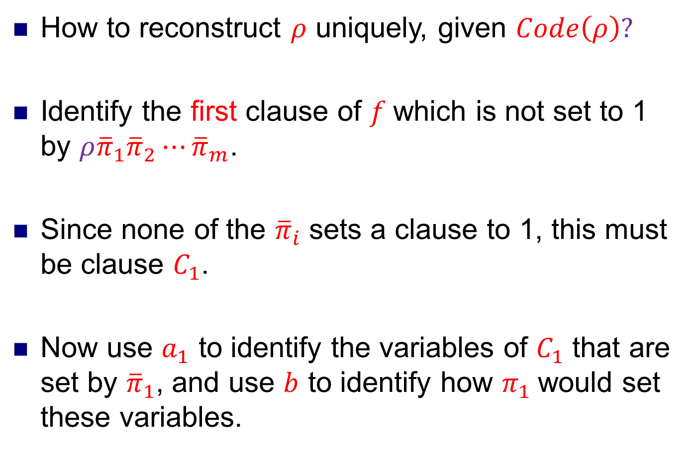
How to reconstruct $ρ$ uniquely, given $Code\left(ρ\right)?$
Identify the first clause of $f$which is not set to 1 by $ρ{\overline{π}}_{1}{\overline{π}}_{2}⋯{\overline{π}}_{m}$.
Since none of the ${\overline{π}}_{i}$ sets a clause to 1, this must be clause $C_{1}$.
Now use $a_{1}$ to identify the variables of $C_{1}$ that are set by ${\overline{π}}_{1}$, and use $b$ to identify how $π_{1}$would set these variables.
$$Code\left(ρ\right)≔⟨ρ{\overline{π}}_{1}{\overline{π}}_{2}⋯{\overline{π}}_{m}, a_{1},⋯,a_{m}, b⟩$$

Slide 20
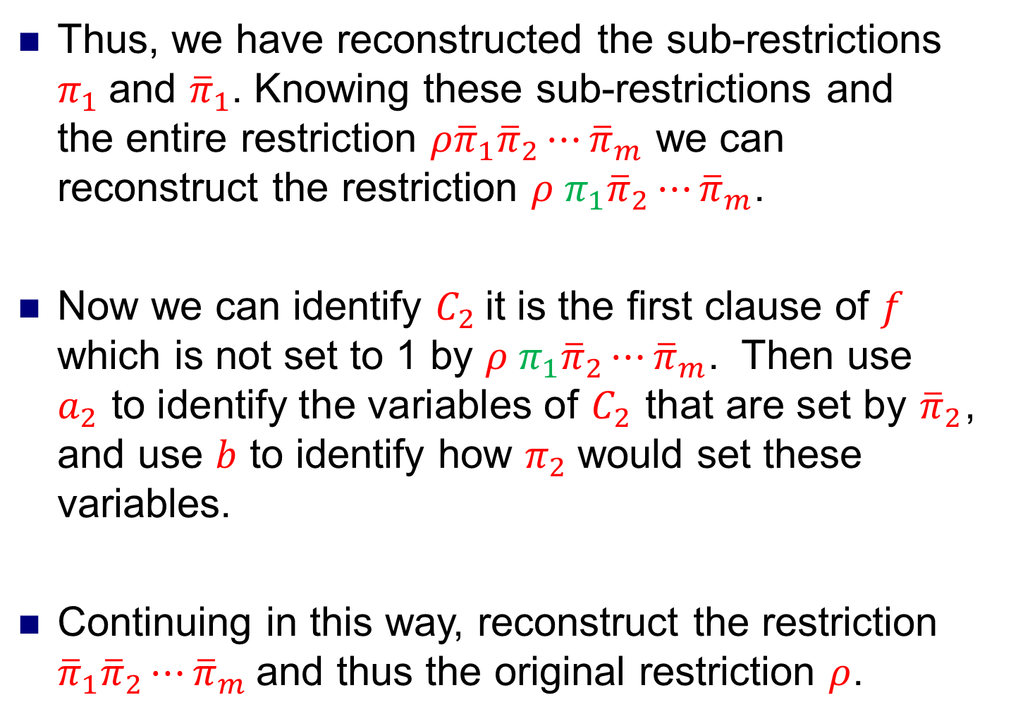
Thus, we have reconstructed the sub-restrictions $π_{1}$and ${\overline{π}}_{1}$. Knowing these sub-restrictions and the entire restriction $ρ{\overline{π}}_{1}{\overline{π}}_{2}⋯{\overline{π}}_{m}$ we can reconstruct the restriction $ρ{ π}_{1}{\overline{π}}_{2}⋯{\overline{π}}_{m}$.
Now we can identify $C_{2}$it is the first clause of $f$ which is not set to 1 by $ρ{ π}_{1}{\overline{π}}_{2}⋯{\overline{π}}_{m}$. Then use $a_{2}$ to identify the variables of $C_{2}$ that are set by ${\overline{π}}_{2}$, and use $b$ to identify how $π_{2}$would set these variables.
Continuing in this way, reconstruct the restriction ${\overline{π}}_{1}{\overline{π}}_{2}⋯{\overline{π}}_{m}$and thus the original restriction $ρ$.

Slide 21
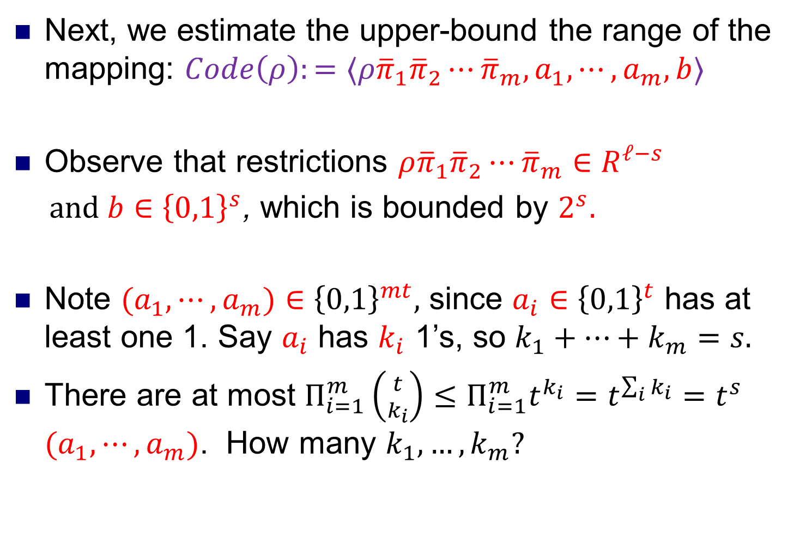
Next, we estimate the upper-bound the range of the mapping: $Code\left(ρ\right):=⟨ρ{\overline{π}}_{1}{\overline{π}}_{2}⋯{\overline{π}}_{m}, a_{1},⋯,a_{m}, b⟩$
Observe that restrictions $ρ{\overline{π}}_{1}{\overline{π}}_{2}⋯{\overline{π}}_{m}∈R^{ℓ−s}$
$and b∈{\left\{0,1\right\}}^{s}$, which is bounded by $2^{s}.$
Note ${(a}_{1},⋯,a_{m})∈$ ${\left\{0,1\right\}}^{mt},$ since $a_{i}$ $∈$ ${\left\{0,1\right\}}^{t}$ has at least one 1. Say $a_{i}$ has $k_{i}$ 1’s, so $k_{1}+…+k_{m}=s.$
There are at most $Π_{i=1}^{m}\left({t \atop k_{i}}\right)≤Π_{i=1}^{m}t^{k_{i}}=t^{\sum_{i}{k_{i}}}=t^{s}$ ${(a}_{1},⋯,a_{m})$. How many $k_{1},…,k_{m}?$

Slide 22
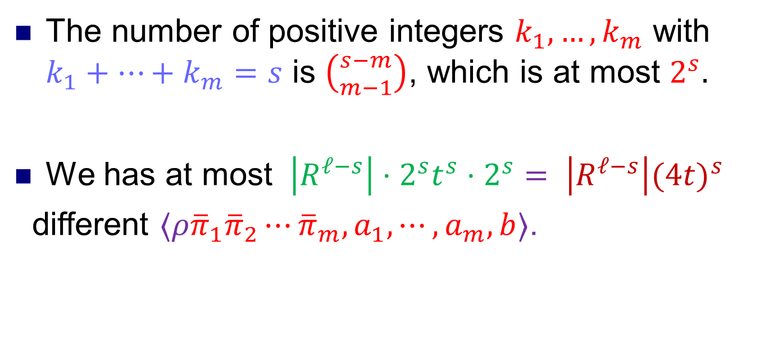
The number of positive integers $k_{1},…,k_{m}$ with $k_{1}+…+k_{m}=s$ is $\left({s−m \atop m−1}\right)$, which is at most $2^{s}.$
We has at most $\left|R^{ℓ−s}\right|⋅2^{s}t^{s}⋅2^{s}= \left|R^{ℓ−s}\right|({4t)}^{s}$
different $⟨ρ{\overline{π}}_{1}{\overline{π}}_{2}⋯{\overline{π}}_{m}, a_{1},⋯,a_{m}, b⟩$.

Slide 23
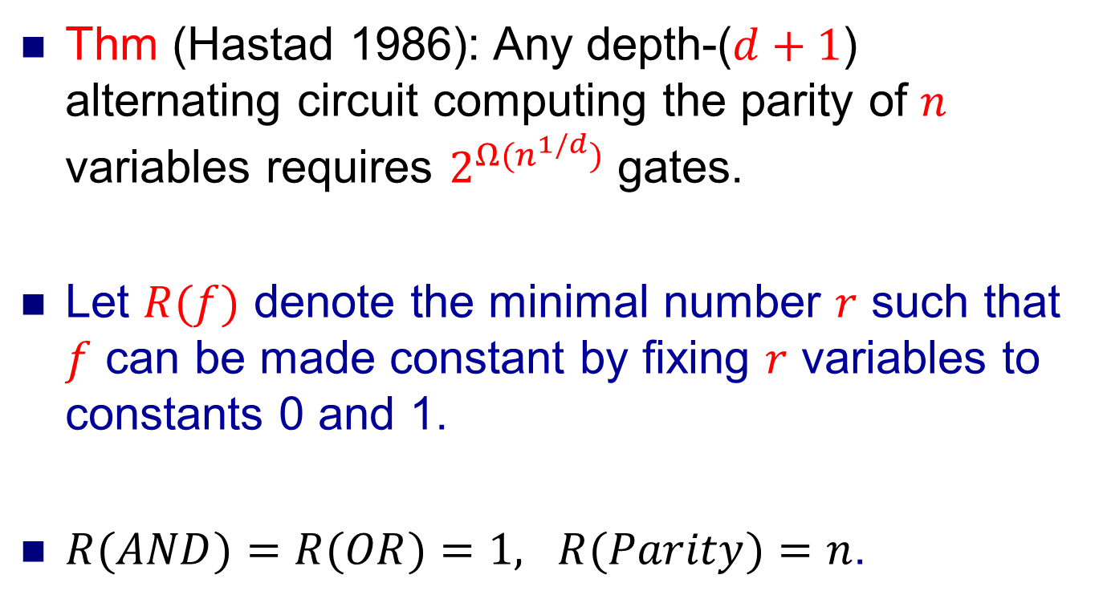

Parity and Majority are not in $AC^{0}$
Thm (Hastad 1986): Any depth-($d+1$) alternating circuit computing the parity of $n$ variables requires $2^{Ω(n^{1/d})}$ gates.
Let $R(f)$ denote the minimal number $r$ such that $f$ can be made constant by fixing $r$ variables to constants 0 and 1.
$R(AND)=R(OR)=1, R(Parity)=n$.

Slide 24
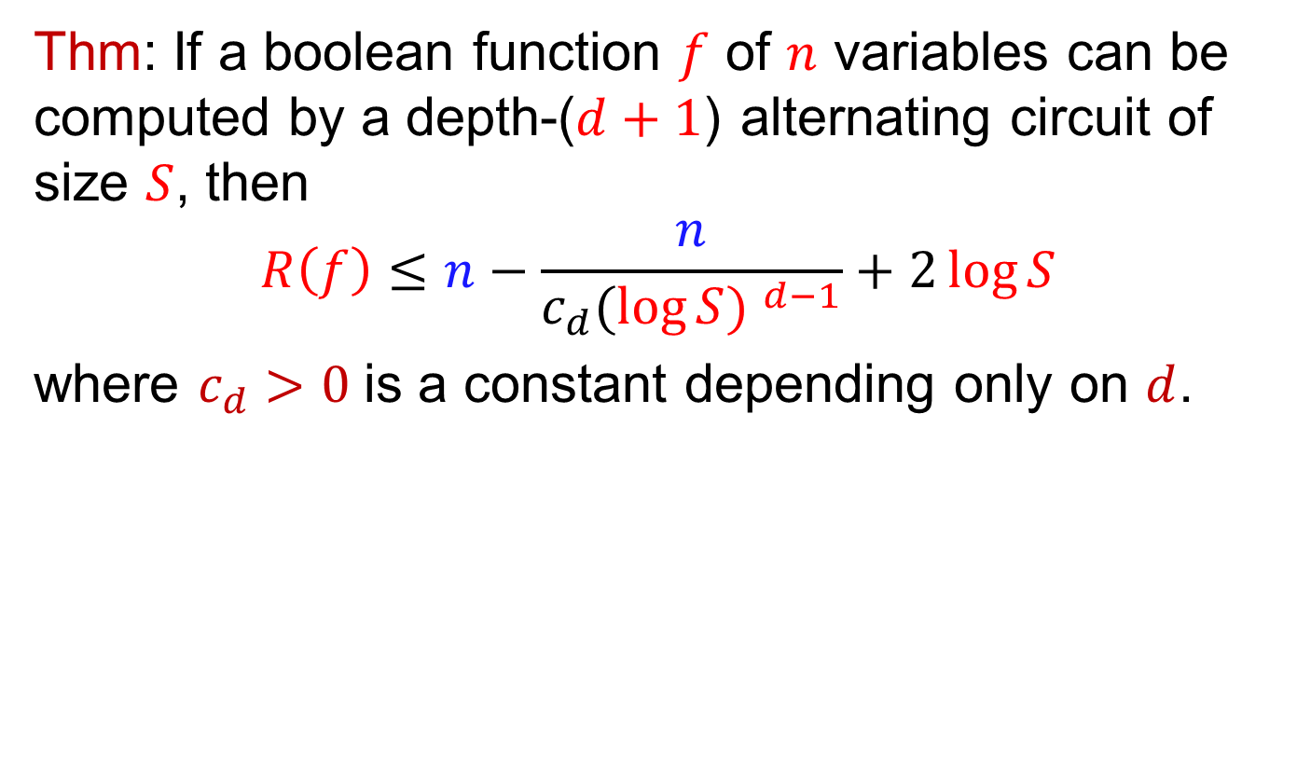
Thm: If a boolean function $f$ of $n$ variables can be computed by a depth-($d+1$) alternating circuit of size $S$, then
$$R\left(f\right)≤n−\frac{n}{c_{d}({\log{S) }}^{d−1}}+2\log{S}$$
where $c_{d}>0$is a constant depending only on $d$.

Slide 25
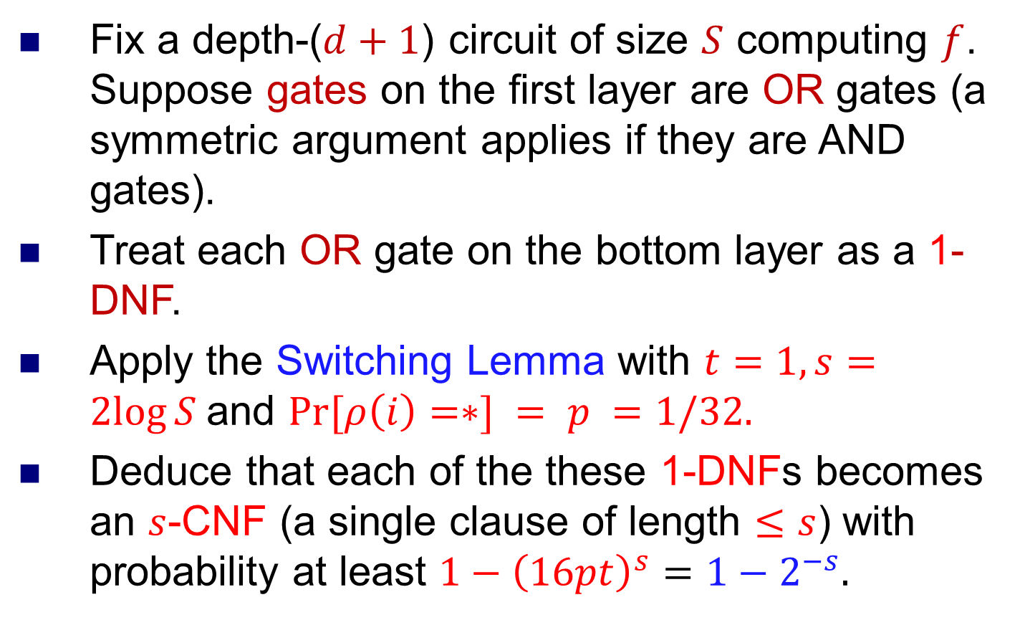

Proof of $R\left(f\right)≤n−\frac{n}{c_{d}({\log{S) }}^{d−1}}+2\log{S}$
Fix a depth-($d+1$) circuit of size $S$ computing $f$. Suppose gates on the first layer are OR gates (a symmetric argument applies if they are AND gates).
Treat each OR gate on the bottom layer as a 1-DNF.
Apply the Switching Lemma with $t=1, s=2log⁡S$and $Pr⁡[ρ\left(i\right)=∗] = p =1/32.$
Deduce that each of the these 1-DNFs becomes an $s$-CNF (a single clause of length $≤s$) with probability at least $1−{\left(16pt\right)}^{s}=1−2^{−s}.$

Slide 26
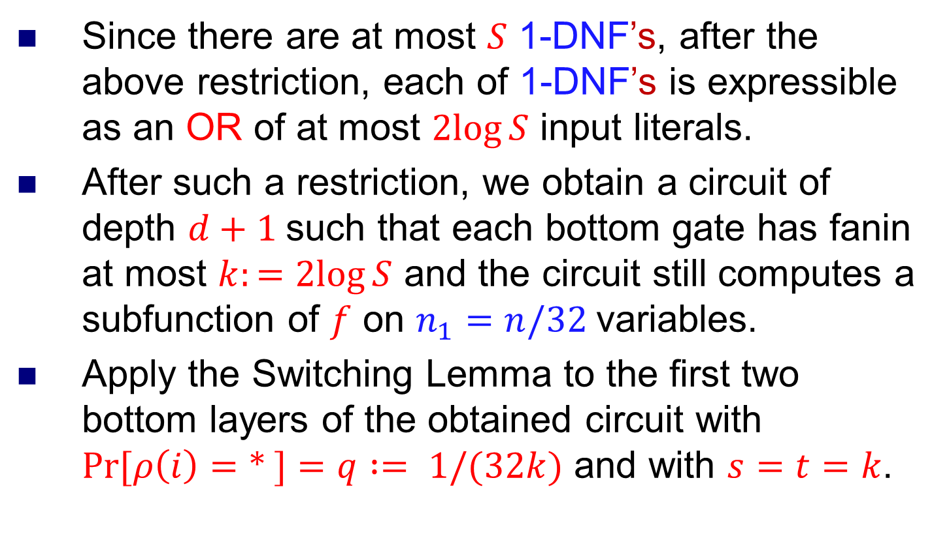
Proof of $R\left(f\right)≤n−\frac{n}{c_{d}({\log{S) }}^{d−1}}+2\log{S}$
Since there are at most $S$ 1-DNF’s, after the above restriction, each of 1-DNF’s is expressible as an OR of at most $2log⁡S$ input literals.
After such a restriction, we obtain a circuit of depth $d+1$such that each bottom gate has fanin at most $k:=2log⁡S$ and the circuit still computes a subfunction of $f$ on $n_{1}=n/32$variables.
Apply the Switching Lemma to the first two bottom layers of the obtained circuit with $Pr⁡[ρ\left(i\right)=∗ ]=q := 1/(32k)$ and with $s=t=k$.

Slide 27
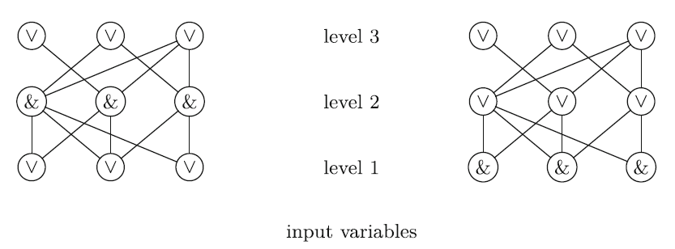

Proof of $R\left(f\right)≤n−\frac{n}{c_{d}({\log{S) }}^{d−1}}+2\log{S}$
Apply the Switching Lemma with $Pr⁡[ρ\left(i\right)=∗ ]=q := 1/(32k)$ and $s=t=k$.
After the restriction, the gate can be replaced by a $k$-DNF with probability at least
$1−{\left(16qt\right)}^{s}=1−2^{−k}=1−S^{−2}.$

Slide 28
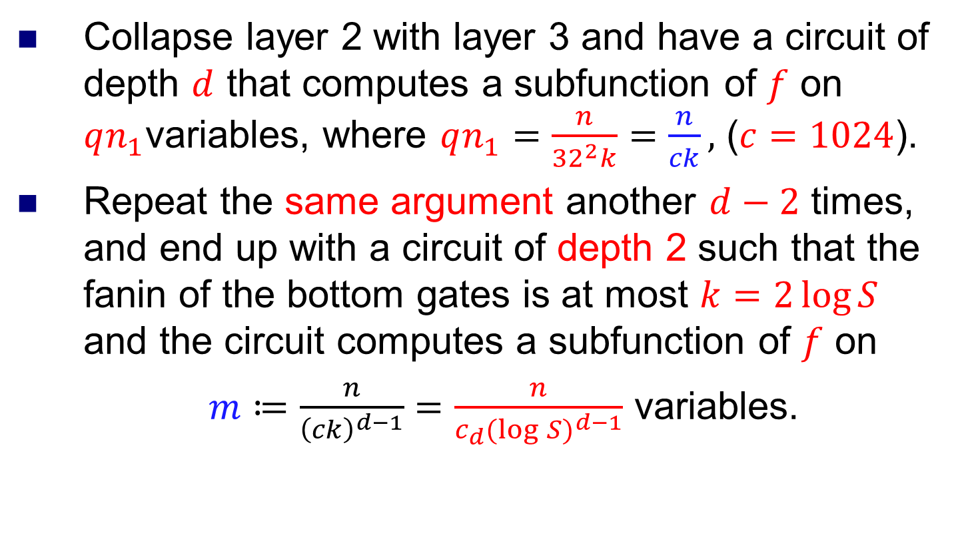
Proof of $R\left(f\right)≤n−\frac{n}{c_{d}({\log{S) }}^{d−1}}+2\log{S}$
Collapse layer 2 with layer 3 and have a circuit of depth $d$ that computes a subfunction of $f$ on $qn_{1}$variables, where $qn_{1}=\frac{n}{{32}^{2}k}=\frac{n}{ck},$ ($c=1024$).
Repeat the same argument another $d−2$ times, and end up with a circuit of depth 2 such that the fanin of the bottom gates is at most $k=2\log{S}$ and the circuit computes a subfunction of $f$ on
$m≔\frac{n}{{\left(ck\right)}^{d−1}}=\frac{n}{c_{d}({\log{S)}}^{d−1}}$ variables.

Slide 29
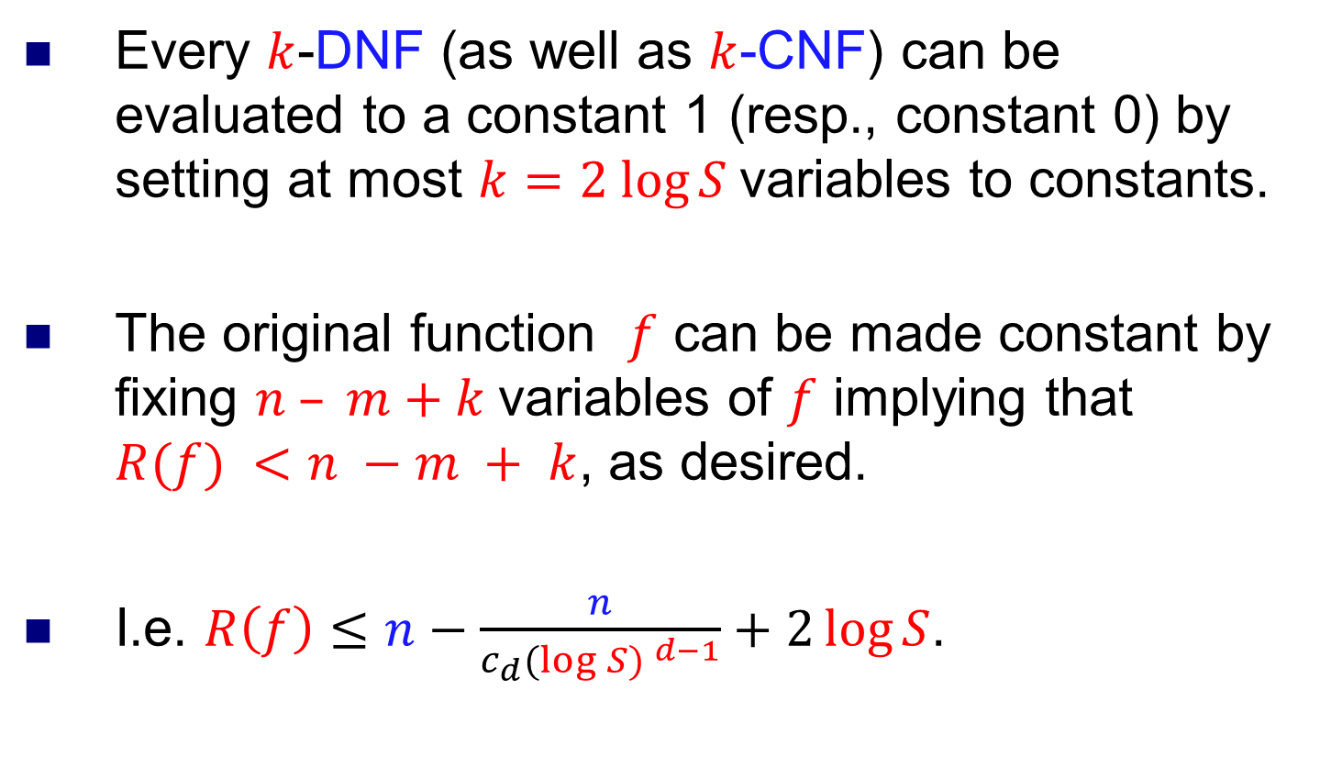
Proof of $R\left(f\right)≤n−\frac{n}{c_{d}({\log{S) }}^{d−1}}+2\log{S}$
Every $k$-DNF (as well as $k$-CNF) can be evaluated to a constant 1 (resp., constant 0) by setting at most $k=2 log⁡S$variables to constants.
The original function $f$ can be made constant by fixing $n – m+k$variables of $f$ implying that $R(f) <n −m + k$, as desired.
I.e. $R\left(f\right)≤n−\frac{n}{c_{d}({\log{S) }}^{d−1}}+2\log{S}$.

Slide 30
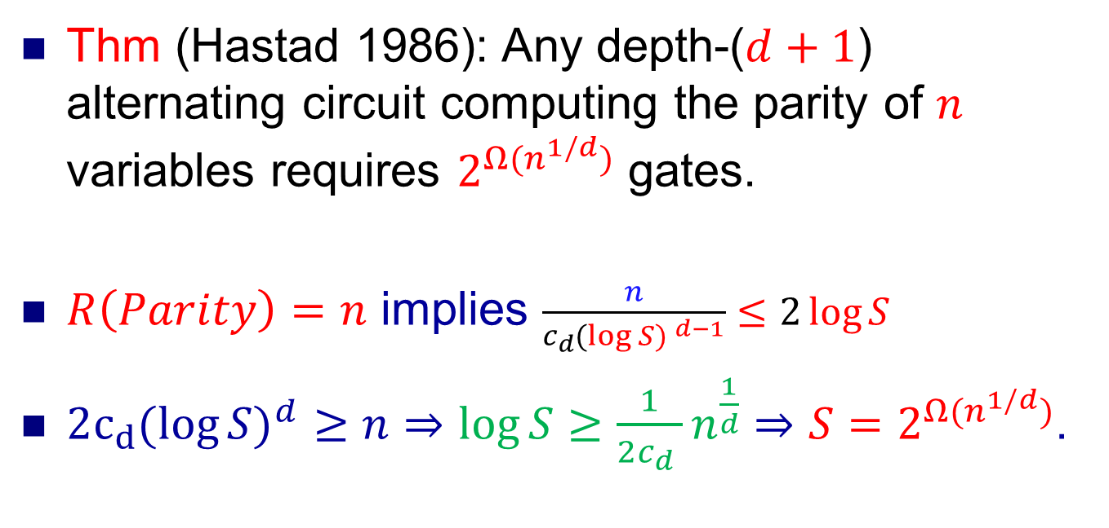
Proof of $R\left(f\right)≤n−\frac{n}{c_{d}({\log{S) }}^{d−1}}+2\log{S}$
Thm (Hastad 1986): Any depth-($d+1$) alternating circuit computing the parity of $n$ variables requires $2^{Ω(n^{1/d})}$ gates.
$R\left(Parity\right)=n$ implies $\frac{n}{c_{d}({\log{S) }}^{d−1}}≤2\log{S}$
${2c_{d}(log{S)}}^{d}≥n⇒\log{S≥\frac{1}{2c_{d} }n^{\frac{1}{d}}}⇒S=2^{Ω(n^{1/d})}$.

